Slide 1

Dr. Tabbasum Naz

Slide 2
OWL Properties
OWL Properties represent relationships between two objects.
There are two main properties:
  Object properties: link object to object
  datatype properties: link object to XML Schema datatype or rdf:literal
OWL has another property – Annotation properties, to be used to add annotation information to classes, individuals, and properties

Slide 3
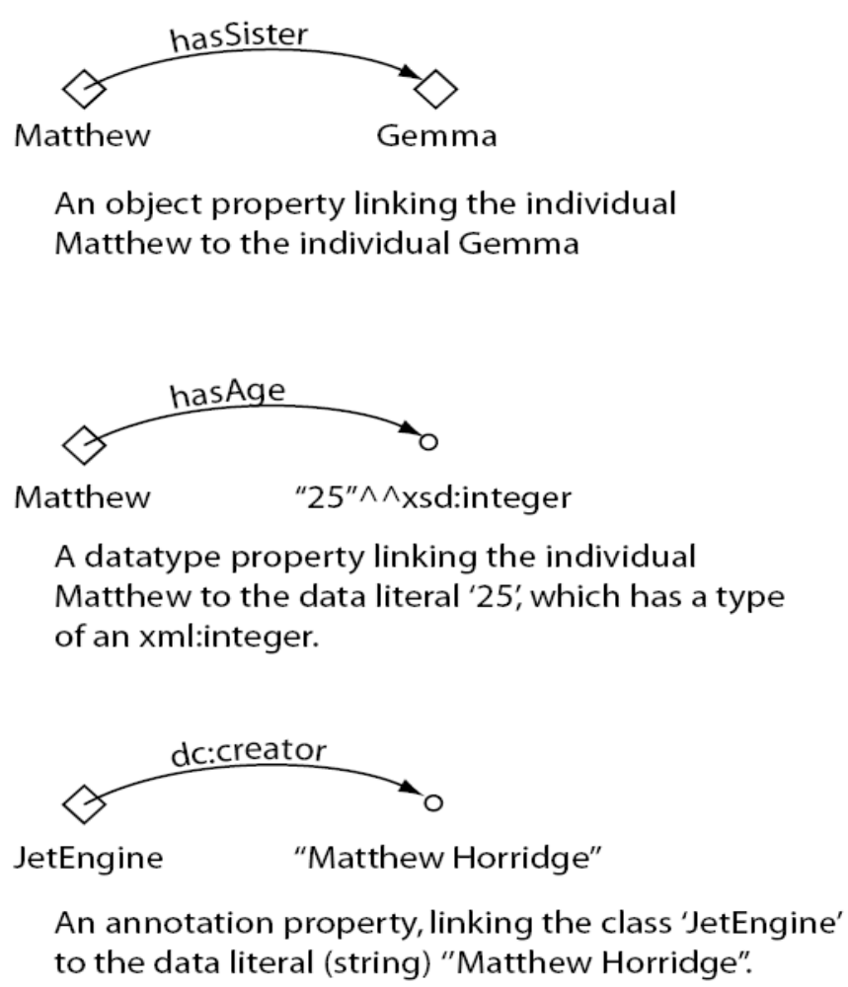

Slide 4
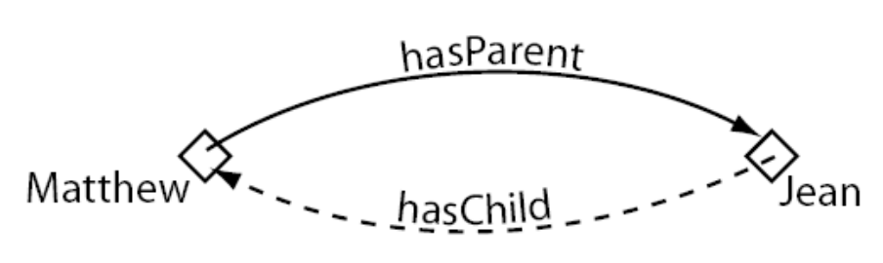
Inverse Properties
Each object property may have a corresponding inverse property.
If some property links individual a to individual b, then its inverse property will link individual b to individual a.

Slide 5
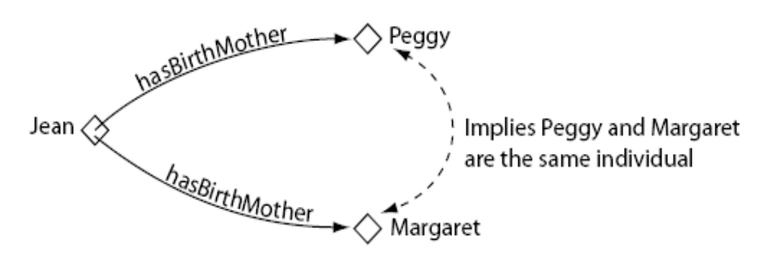
Functional Properties
If a property is functional, for a given individual, there can only be at most one individual to be related via this property.
  For a given domain, range must be unique
Functional properties are also known as single valued properties.

Slide 6
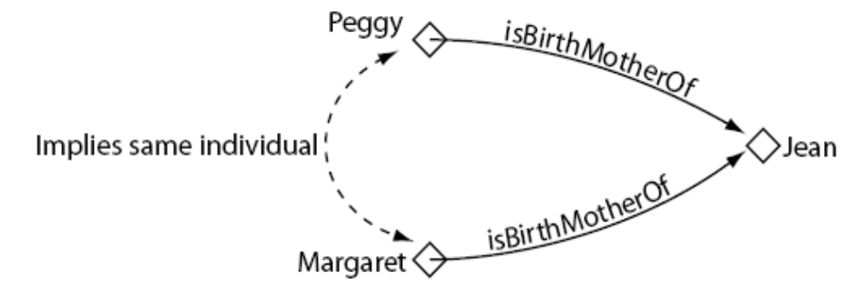
Inverse Functional Properties
If a property is inverse functional, then its inverse property is functional.
  For a given range, domain must be unique.

Slide 7
Functional vs. inverse functional properties
FunctionalProperty vs InverseFunctionalProperty
 | domain | range | example
Functional Property | For a given domain | Range is unique | hasFather: A hasFather B, A hasFather C →B=C
InverseFunctionalProperty | Domain is unique | For a given range | hasID: A hasID B, C hasID B →A=C

Slide 8
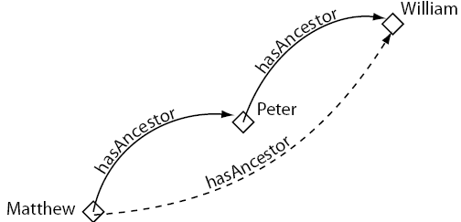
Transitive Properties
If a property is transitive, and the property related individual a to individual b, and also individual b to individual c, then we can infer that individual a is related to individual c via property P.

Slide 9
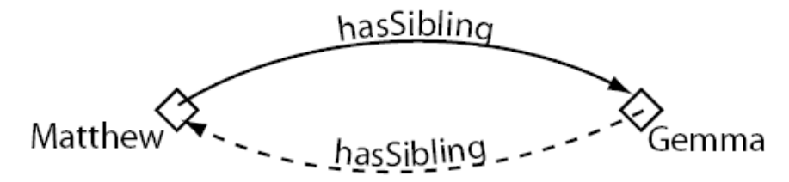
Symmetric Properties
If a property P is symmetric, and the property relates individual a to individual b, then individual b is also related to individual a via property P.

